Slide 1
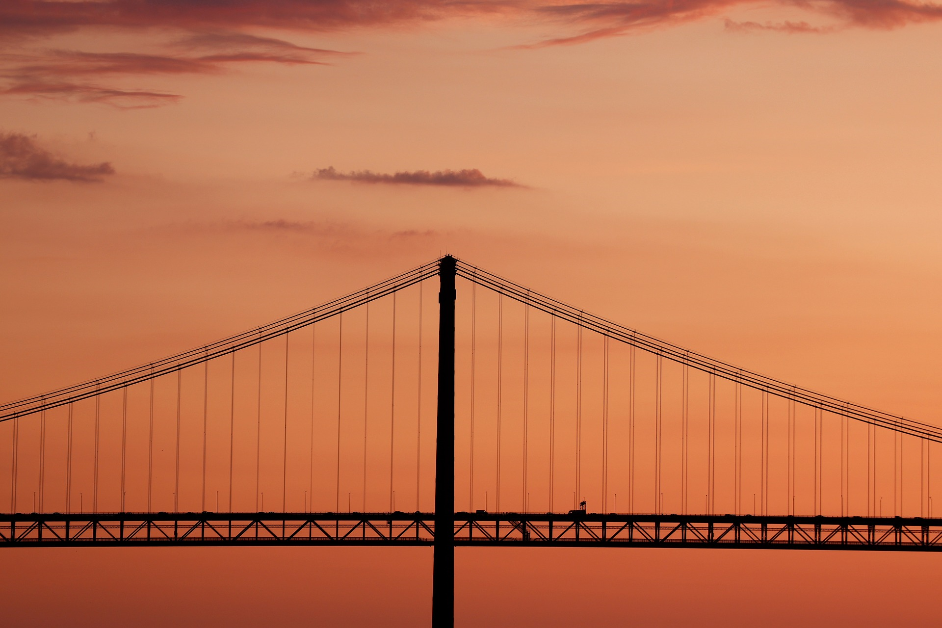
ME 270: Project
Team #, Section #: Team members: Xxxxx, Yyyyyy and Zzzzzz

Slide 2
Title slide info
Keep minimal
Different font sizes create visual hierarchy
Larger text more important (title)
Stock photo creates interest
(see slide 1)

Slide 3
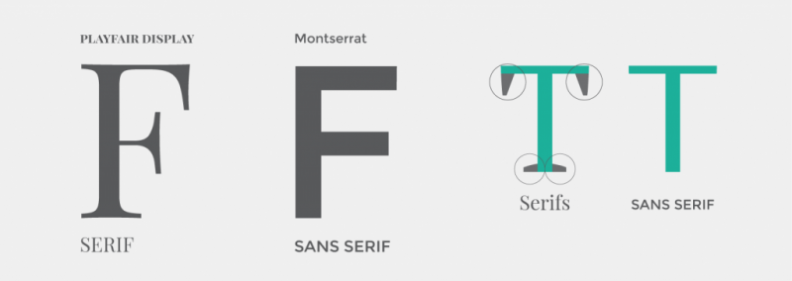
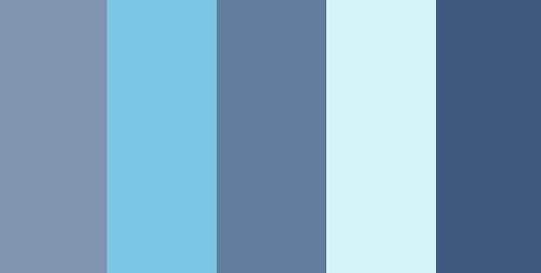
Power Point Design
Fonts
Minimum of 18-point font
24 is better
Avoid italicized fonts and ALL-CAPS
Colors
Use less than 5 colors
Do NOT pair red and green
Image 1: San Serif vs Serif Fonts (Easil)
Image 2: Orange, Red, and Black
(Digital Synopsis)
Image 3: Blue Colors (Envato)

Slide 4
Number of Slides
Limit the number of slides.
Constant “flipping" loses the audience
1-2 slides per minute

Slide 5
Content Slides
When using bullet points:
Use the 6 x 6 Rule
One thought per line
No more than 6 words per line
No more than 6 lines per slide
Without bullet points, use maximum of 8 words

Slide 6
More Content
Can vary slides between:
Bullet points
Text and images
Two columns
No bullet points
Be consistent with all other formatting:
font, color, background

Slide 7
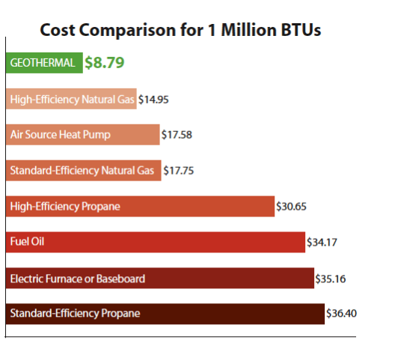
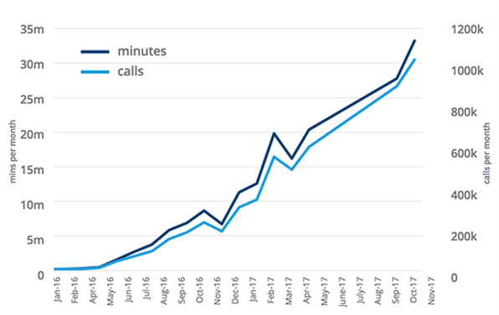
Power Point Design
Charts and Graphs
Pie Charts [show percentages]
Vertical Bar Charts [change over time]
Horizontal Bar Charts [compare quantities]
Graph 1: Cost Comparison (Geothermal - Detmer And Sons)
Graph 2: Graph Title

Slide 8
More Design
Images
Use one or two large images
Use the same style of image [if possible]
Keep the image quality high

Slide 9
References (examples)
Image 1: “Easil.” Easil, 4 Feb. 2018, https://about.easil.com/support/serif-vs-sans-serif/.
Image 2: “Digital Synopsis.” Digital Synopsis, https://digitalsynopsis.com/design/logo-color-combinations/.
Image 3: “Envato.” Envato, Coolors, https://envato.com/blog/holiday-color-palettes-arent-just-red-green/.
Graph 2: "Geothermal - Detmer And Sons". Detmer And Sons, 2019, http://www.detmersons.com/geothermal/.

Slide 10
References
How to Cite Sources:
APA (American Psychological Association) – generally used for academic documents in Education, Psychology, Social Sciences, and Sciences
MLA (Modern Language Association) - generally used by writers and documentation in the Humanities
Chicago style - generally used for academics in Business, History, and the Fine Arts

