Slide 1
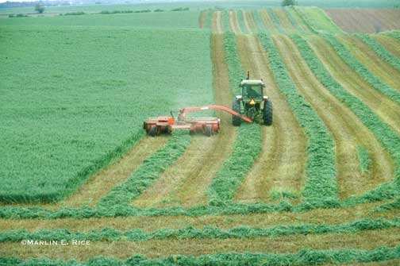
Alfalfa Breeding –
A Synthetic Cultivar

Slide 2
Selection of Parents
Phenotypic Selection:
Identify individual clones with desirable phenotype
Clonal evaluation with replicated testing of individuals reproduced by vegetative propagation
More efficient in traits with high heritability
Genotypic Selection:
Select superior individuals based on progeny performance and general combining ability using a polycross with other selected clones for pollination
Superior to phenotypic selection for traits with low heritability
Notes:
Clonal evaluation permits the elimination of inferior individuals before expensive replicated tests for combining ability are initiated
High correlation between performance of clone and its combining ability for maturity, leaf width, disease resistance, and growth habit

Slide 3
Recurrent Phenotypic Selection
Often used to select for insect and disease resistance in alfalfa
Most efficient in highly heritable traits
10,000 Individuals
Select Desirable Individuals
10% Selection
Recombine 1,000 Selected Clones
Evaluate Individuals
Recombine
Phenotypic Selection
Notes:
Recurrent phenotypic selection is used for improving populations
Goal is to increase the favorable genes

Slide 4
Development of a Synthetic Cultivar
100 superior clones identified = SYN 0 Generation
All clones are intermated in isolation cages
using insect pollination
An equal amount of seed is harvested from
each mating and bulked to form the SYN 1 Seed
Notes:
More unrelated parents (broad based synthetic) decreases the level of inbreeding and improves the performance of the experimental synthetics

