Slide 1
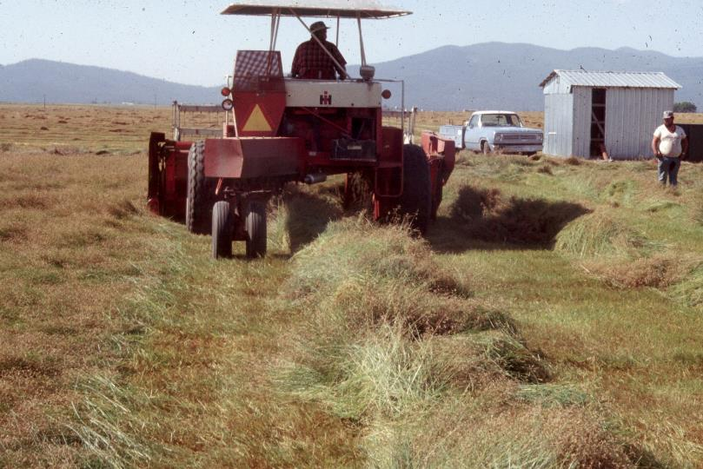

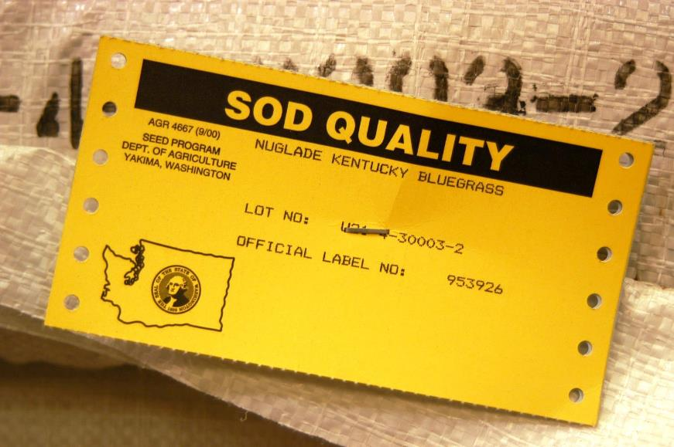
How Seed Production & Certification Work
Prepared by Dr. Doug Brede
Jacklin Seed by Simplot
This presentation covers the topics of where turfgrass seed comes from, how seed certification works, how a person enters a new variety into certification, and how to read and use a seed label to find the best quality seed to plant. This presentation was prepared by Dr. Doug Brede, the Research Director at Jacklin Seed by Simplot, who has been an active breeder in the turfgrass industry for 25 years.

Slide 2
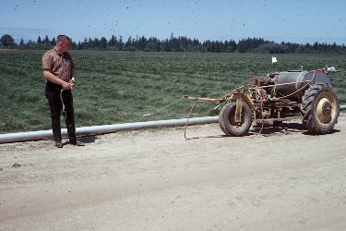
Meet Walt: A true story
This is a true story of Walt. Walt is a real person who had a knack for invention. Here Walt is showing off one of his inventions, an automated sprayer that follows you through production fields as you spot spray weeds. Walt was a tinkerer, always looking for the next great gadget.
2

Slide 3
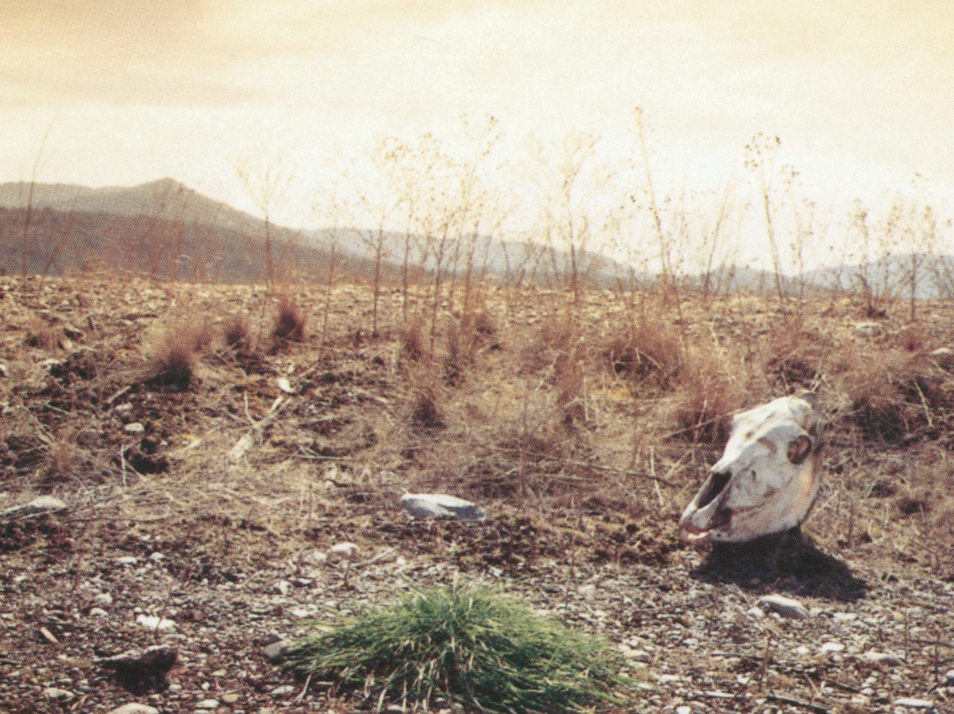
Discovery
One day he was out in the desert area of Washington State when he came upon a green plant growing among dry, dead plants on a rural roadside.
3

Slide 4
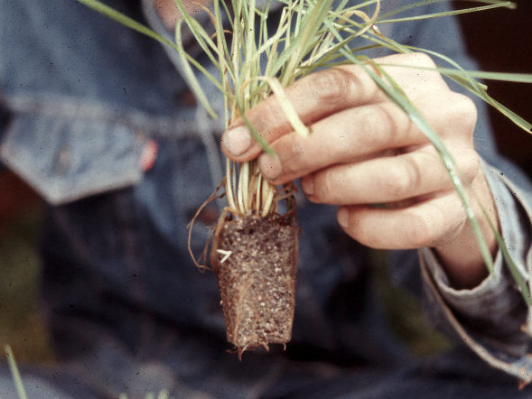
Identification
So he took a plug of the plant, raised it and identified it. He discovered it was Kentucky bluegrass and decided that the turf industry should take advantage of it.
4

Slide 5
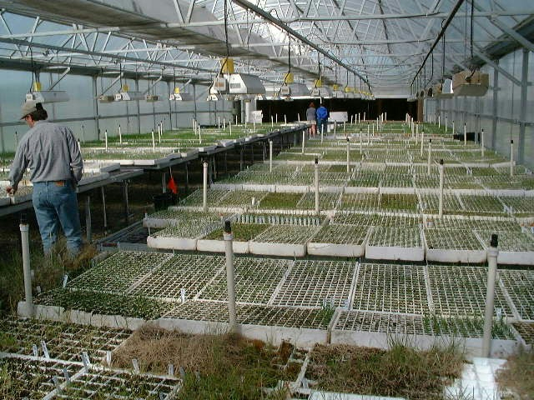
Propagation
So he divided the plant and multiplied it in a greenhouse to increase it.
5

Slide 6
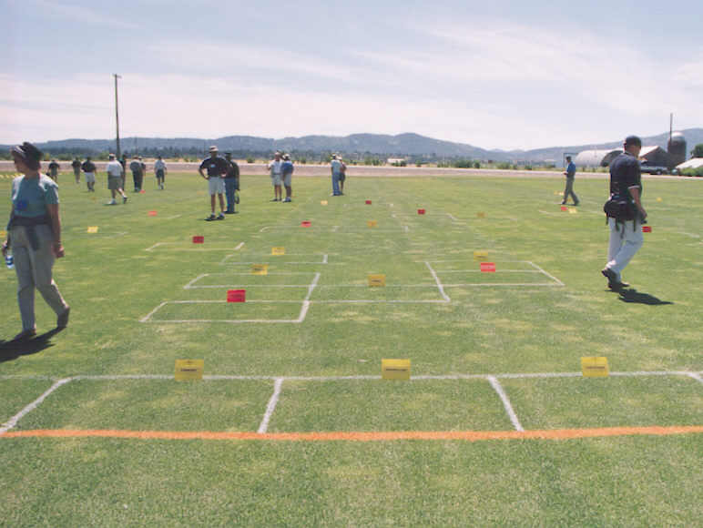
Testing
He planted the variety in numerous turf plots across the country.
7

Slide 7
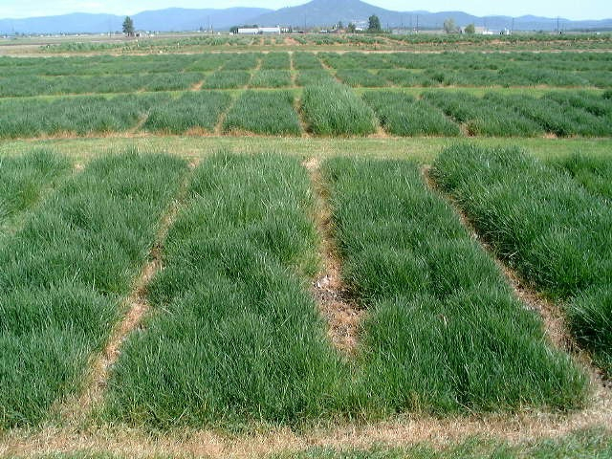
More testing
Yield testing
In addition to turf testing for his new variety, it is important to test for seed yield. If a variety does not produce a good quantity of viable seed, it will never become a commercial variety. Here is a yield trial in Idaho typical for experimental Kentucky bluegrasses.
8

Slide 8
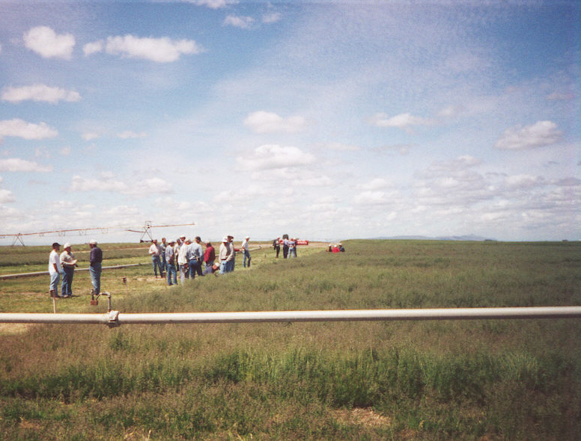
More testing
Then Walt went to sell his idea to the toughest customers of all: the seed farmers of the Pacific Northwest. Here is a large production field trial of new potential turf varieties. Farmers pick between the new varieties to decide which they want to grow. Farmers are independent; they have free choice of which varieties they will grow and which they won’t.
Production field testing
9

Slide 9
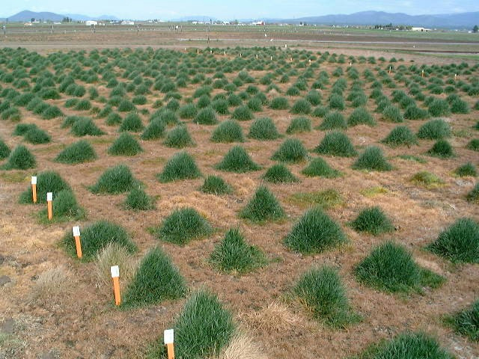
Walt can handle the small plot production himself…
To increase his variety, Walt felt perfectly capable of handling a small plot production block like you see here.
11

Slide 10
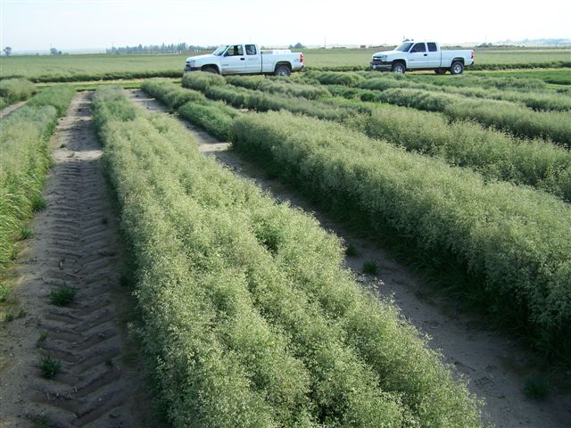
And even the larger blocks of production increase…
He might even be able to handle larger blocks like these by himself.
12

Slide 11
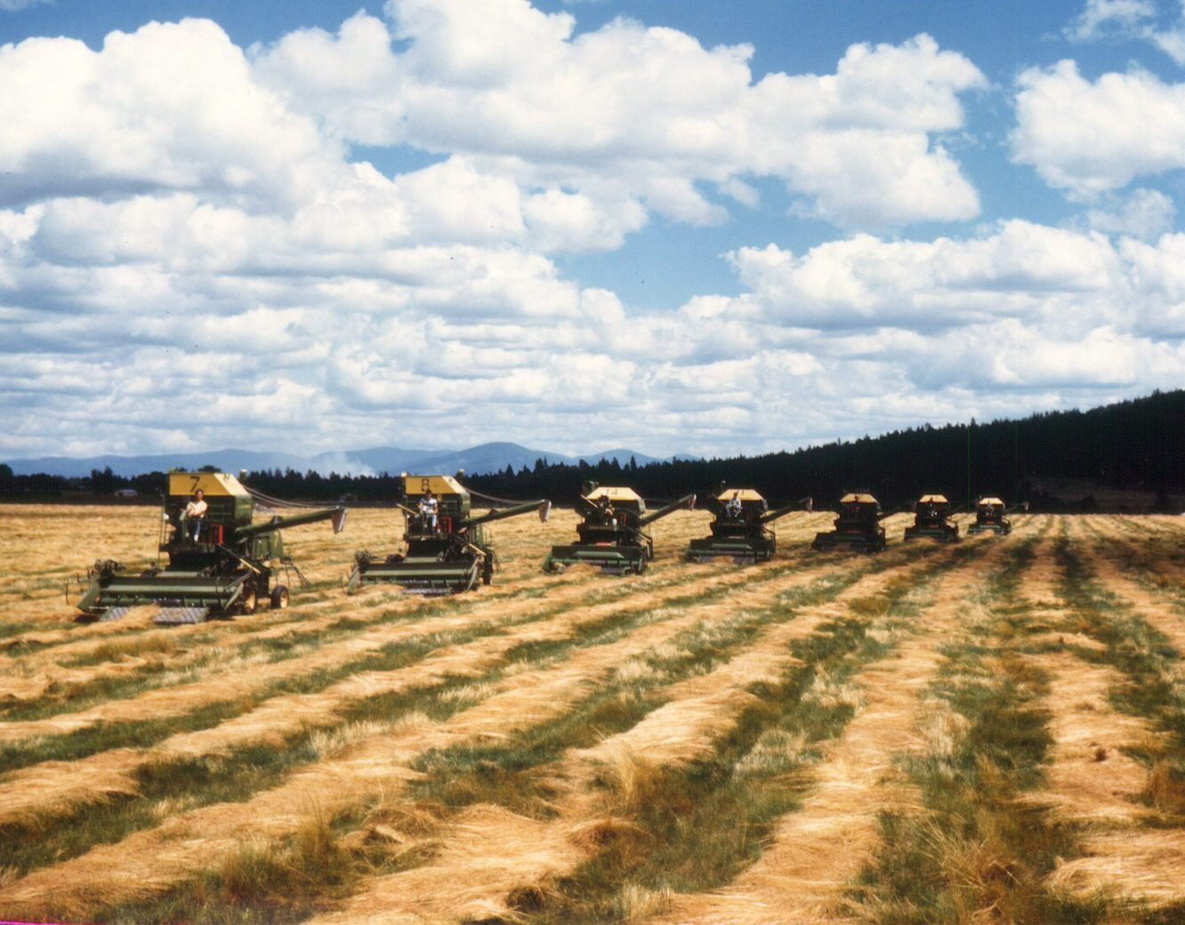
But how does he maintain quality control when geared up to…
100,000 lbs. or…
1,000,000 lbs.
But once the variety is geared up to hundreds or thousands of acres and to 100,000 or a million pounds, it really gets out of the hands of one individual to be able to handle production and keep the quality high. At that point he has to hand his variety over to the best friend of the breeder – the grass seed certification system.
13

Slide 12
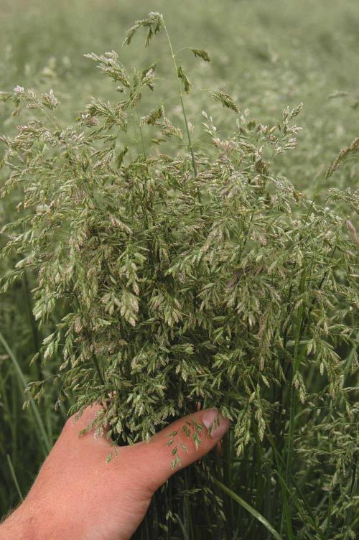
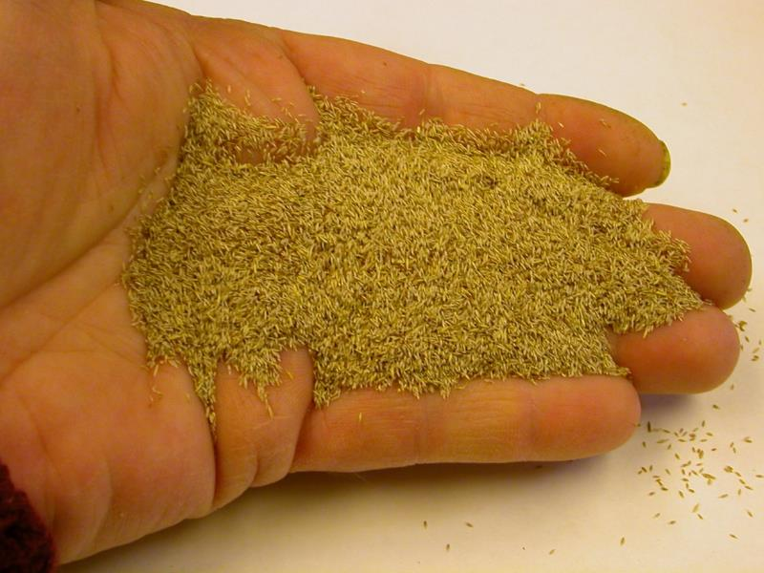
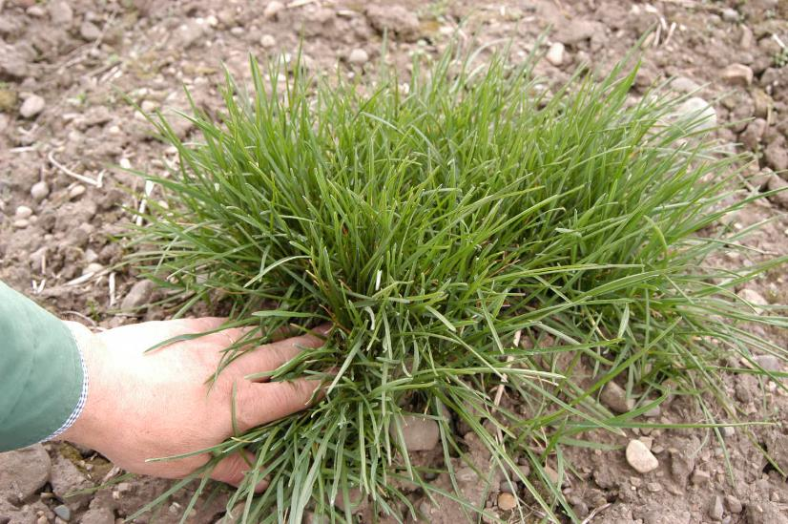
To initialize his variety, Walt began with a single plant. That plant was allowed to produce seedheads and ultimately a handful of seed.
17

Slide 13
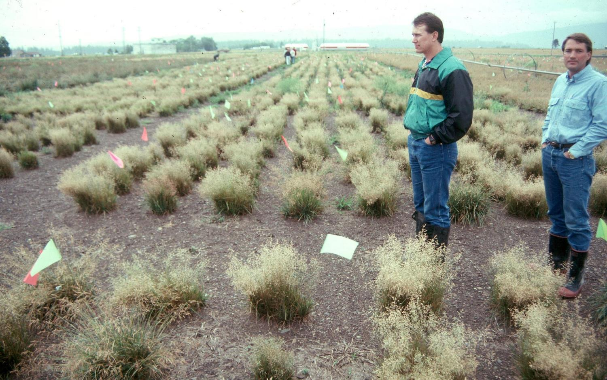
Breeder block – used to purify a cultivar
The next step was to take that seed and to plant a Breeder Block, as you see here. In this Breeder Block each plant originated from one single seed. The plants marked with a flag are called variants or off-types and are removed from the population prior to harvest. The purpose of the Breeder Block is to purify the variety to 100% purity to start into seed production. A Breeder Seed tag, signed by the breeder, is used to identify this lot and trace it back to the original production.
18

Slide 14
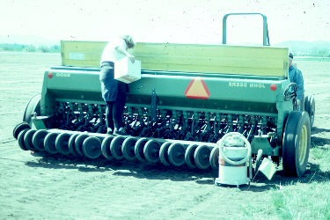
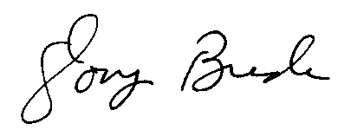
Breeder Seed
Crop 2008 Lot 08-93A
Seedstock production progresses from Breeder Seed, to Foundation Seed, and ultimately to Certified Seed, which is purchased by the consumer. Quality seedstock requires: Identity preservation, field history, and clean planting equipment. Notice in the photograph the tank vacuum cleaner on a very long extension cord. It is being used to clean any stray seed from the planter before planting seedstock.
19

Slide 15
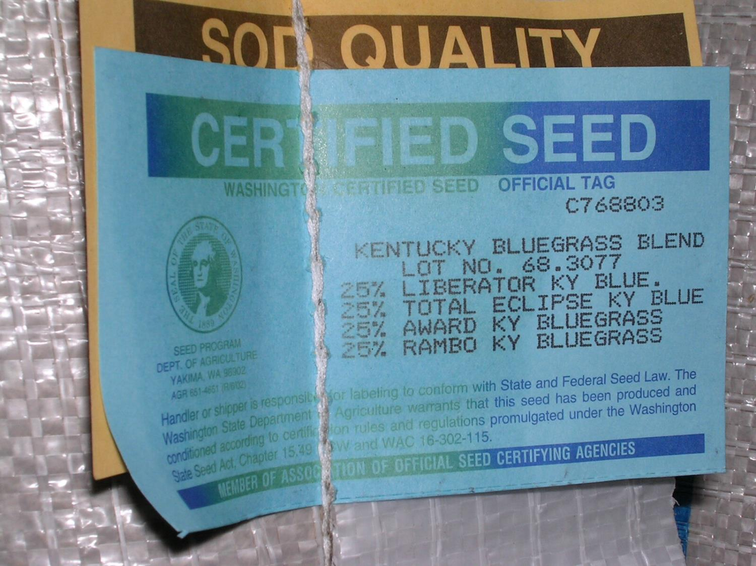
Certified Seed
Is your guarantee of varietal purity and seed quality
73

Slide 16
Remember Walt…?
Certification acts as his team to watch over his variety when it’s grown in perhaps several states and dozens of fields. Certification maintains quality control on a large scale that lives up to the breeder’s goals – when Walt is not around to do the policing himself.
66

Slide 17
Q: How do you enter a new variety into certification?
A: You must describe your variety so the certification inspectors know what to look for.
67

Slide 18
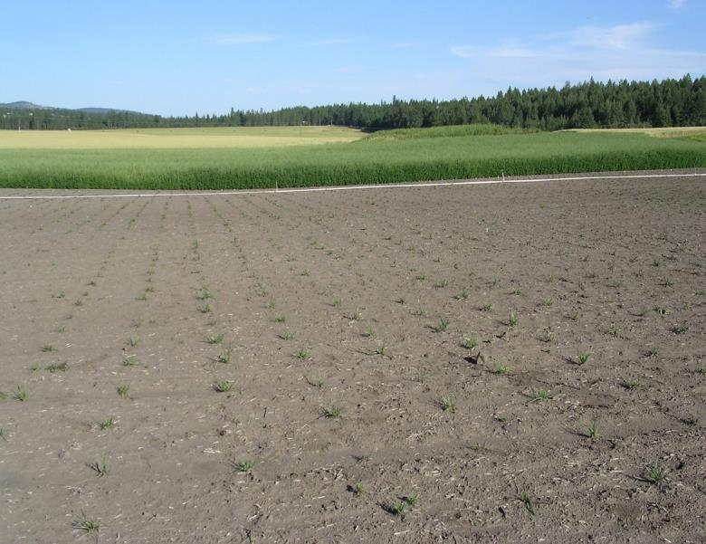
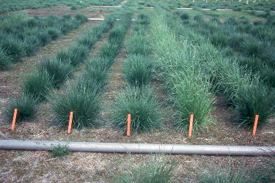
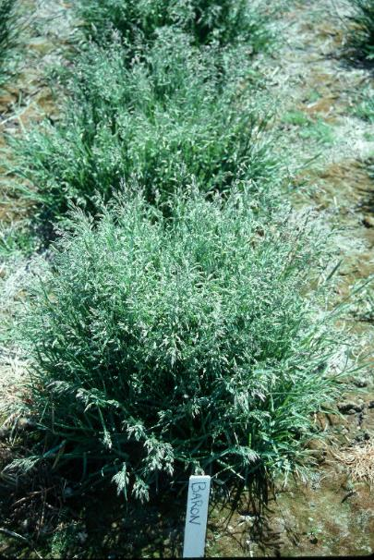
Plant trials
To do this you must plant field trials of your variety so you can grow it out, measure its characteristics, and compare it with existing varieties. On the bottom left is a typical tall fescue certification trial. Look at the plant characteristics of various varieties in the rows. It’s clear to see the Kentucky-31 tall fescue in the second row from right.

Slide 19
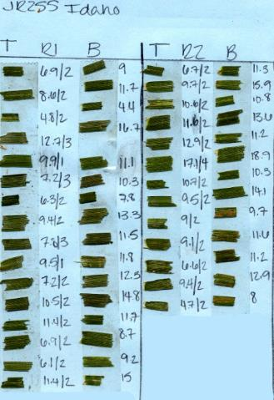
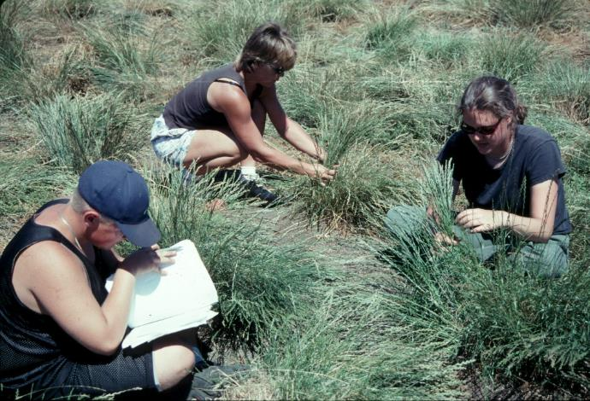
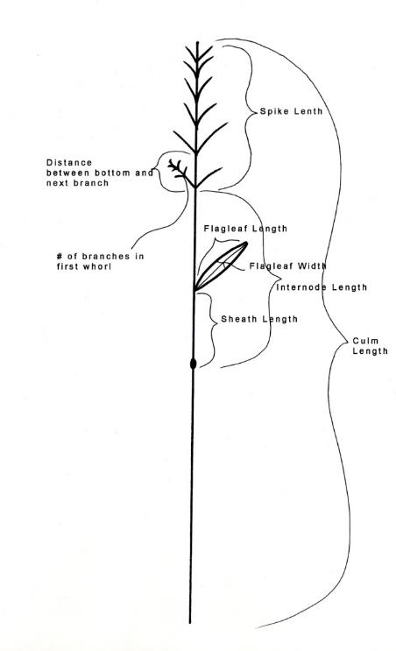
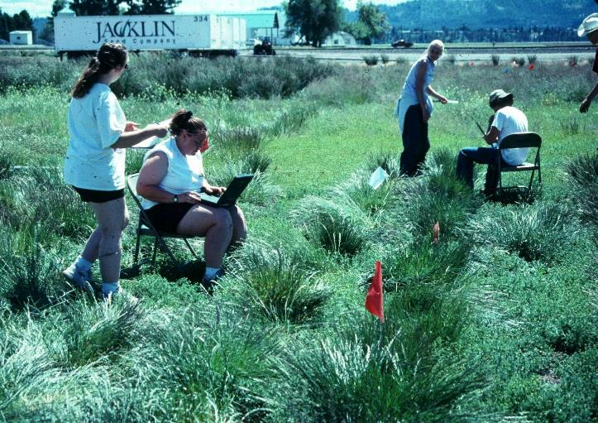
Measure plants
At maturity you must measure the characteristics of the plants so you can describe them to certification inspectors. This includes leaf width, number of culms (seed stems) per plant, dimensions of the seedhead, flag leaf, etc.
69

Slide 20
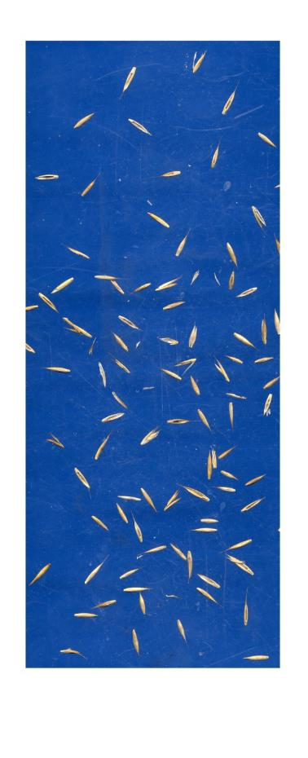
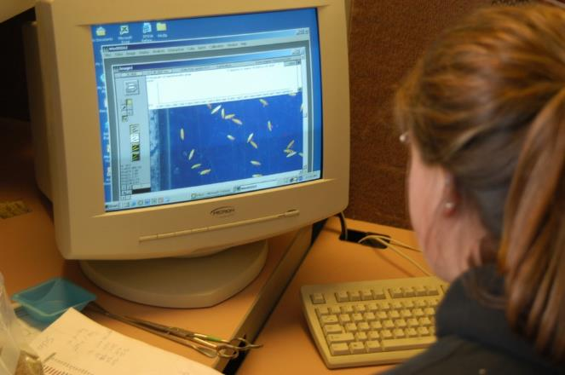
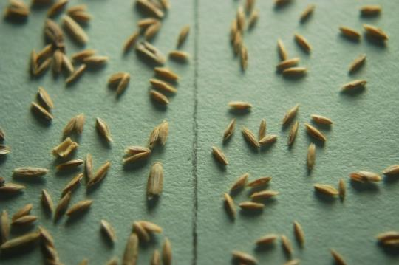
Measure seed
You also have to measure the seed and its characteristics. In this photograph you can see an automated measurement being taken with a scanner using modern software.
70

Slide 21

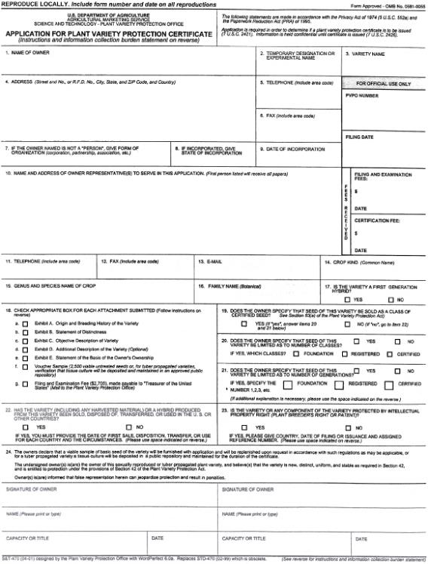


Then you must statistically analyze the data and present it on forms to the inspectors so that they have a gauge to understand your variety.

Slide 22
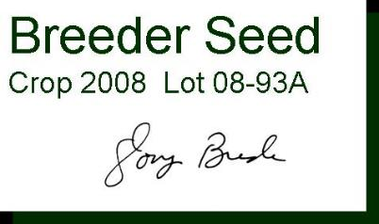
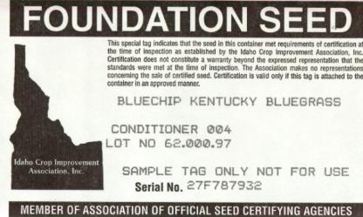
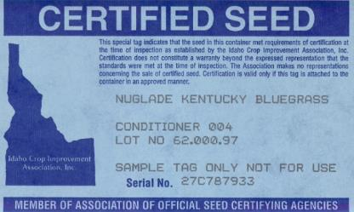
The sequence of seedstock production: Breeder Seed is grown in a Breeder Block. Breeder Seed harvested from that block is planted and one year later, Foundation Seed is harvested from that field. Then Foundation Seed is planted in another field and Certified Seed is harvested. Typically, a breeder might produce ten pounds of Breeder Seed which is increased in the Foundation generation to a thousand pounds of seed. In the Certified Seed generation as much as one million pounds of seed may be produced for public use.
Seed increase
Identity preservation
10 lbs.
1000 lbs.
1,000,000 lbs.
20

Slide 23
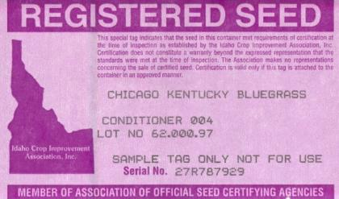
Seed increase
Identity preservation
Sometimes it may be necessary to insert an additional generation between Foundation Seed and Certified Seed, called Registered Seed. This allows an additional seed increase step. All of these steps of Foundation, Registered and Certified Seed are policed by the Association of Official Seed Certifying Agencies or AOSCA. Note the color of the various tags, which is standardized nationwide.
21

Slide 24
Seed Production
Turfgrass seed is grown in several places across the United States. Kentucky bluegrass is grown predominantly in Washington State with smaller amounts in Idaho, Nebraska and Minnesota. Perennial ryegrass, fine and tall fescue, and bentgrass are grown primarily in the Willamette Valley of Oregon. Bermudagrass is grown in southern California and southwestern Arizona. Zoysiagrass seed is grown in one county in southern Georgia.
Kentucky bluegrass
Ryegrass fescue
bent
Zoysia
Bermuda
22

Slide 25
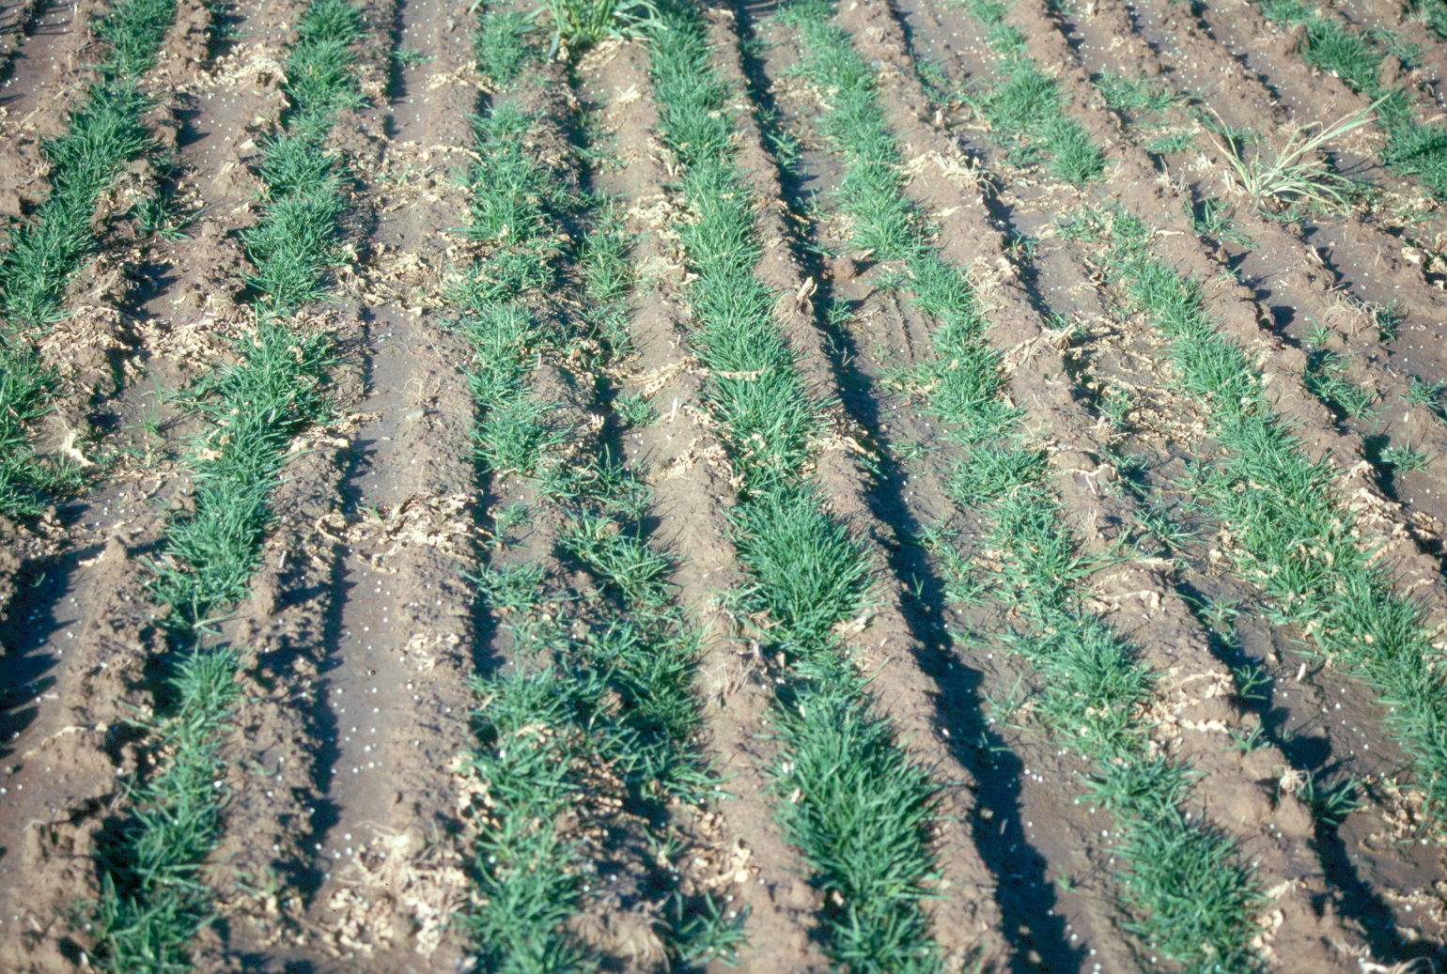
Seeding rates for a seed production field are low compared to turf or sod. A seed grower may plant one to ten pounds per acre whereas a sod grower may plant one to ten pounds of seed per 1000 square feet. When the seed certifying inspector comes to check the field, he or she wants to see no emerging crop in between the rows. This indicates that no volunteers are coming from a previous crop that may interfere with varietal purity.
Typical seeding rate
1-10 lbs. per acre
Nothing growing between rows
24

Slide 26
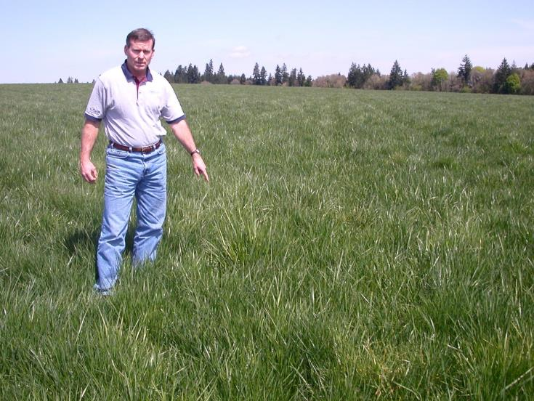
Four certification inspections
During the cycle from planting to seed production, the seed certifying agencies do four separate inspections to make sure the crop is pure. The first inspection starts with examining pre-plant records of the variety, where it came from, and who handled the seed. The second stage is to check for field cleanliness between the rows in the seedling stage. The third step is to look at the crop during the heading stage for off-type plants that are not varietal. The final inspection is in the laboratory for purity, germination and weeds in the seedlot.
25

Slide 27
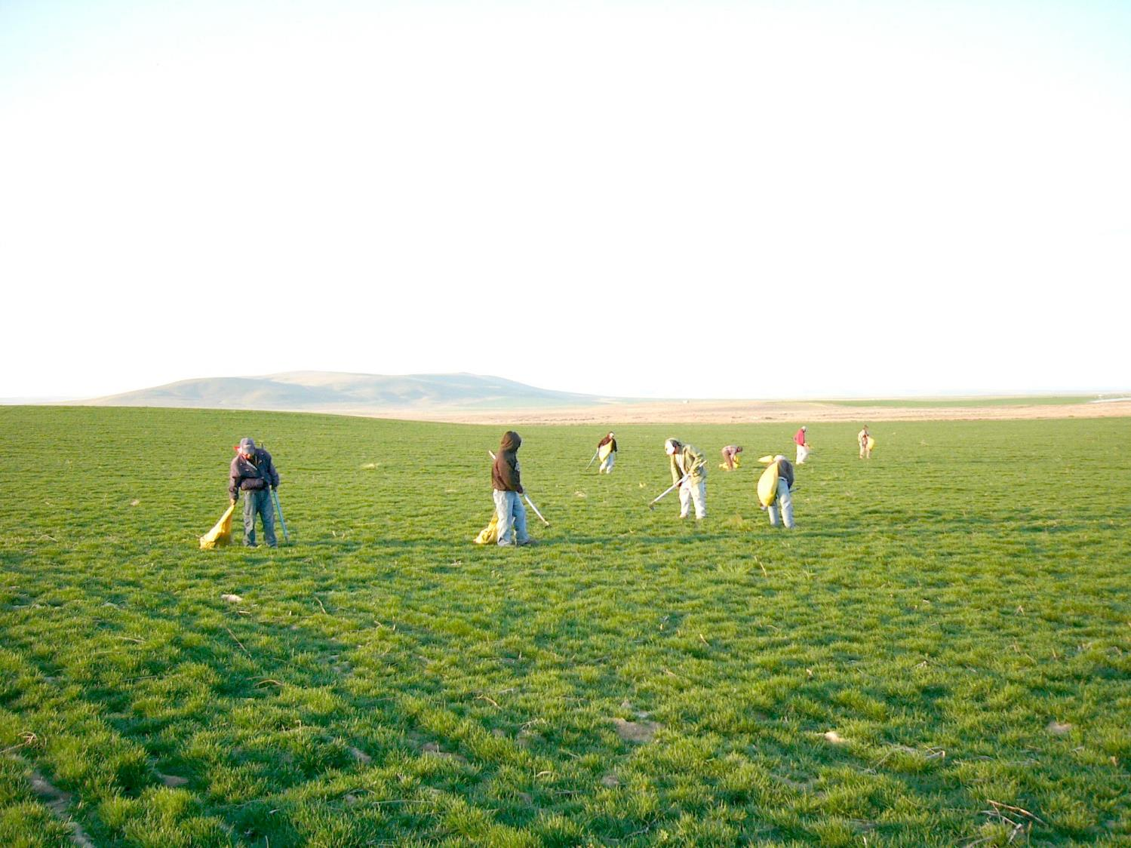
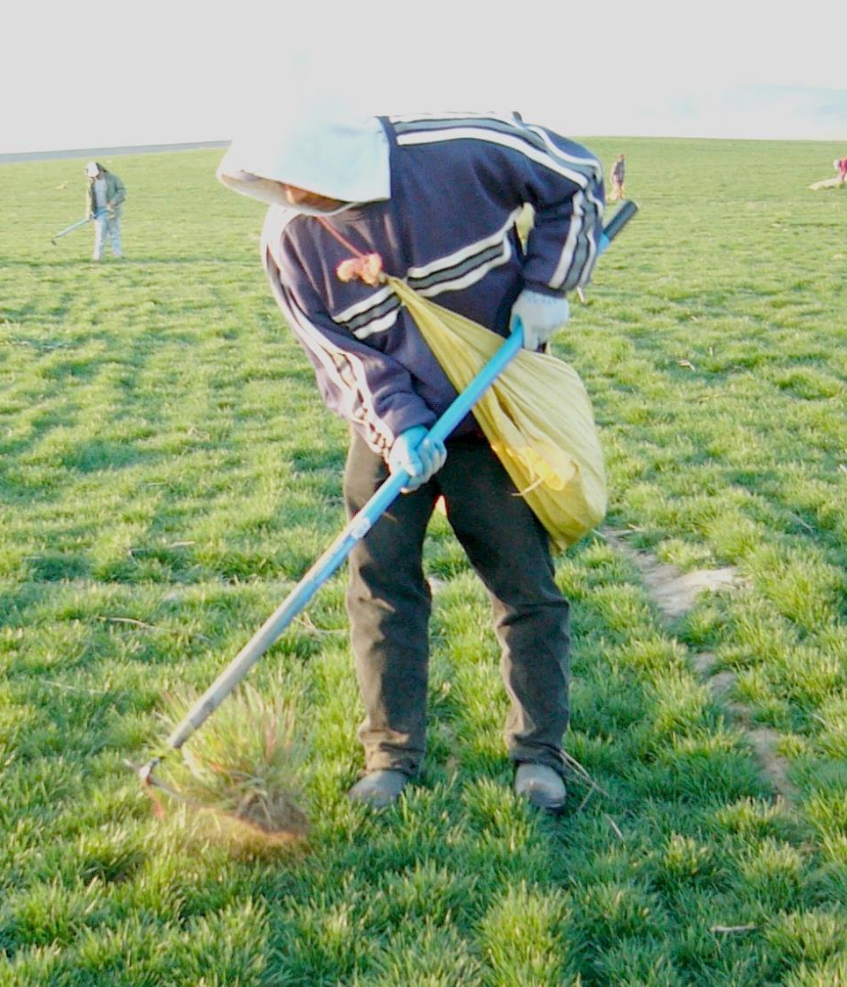
Roguing
Roguing is the process of removing weeds and off-type plants from a seed production field. Here you can see a 128-acre field with a number of field workers with hoes and bags walking the field to individually remove weeds.
26

Slide 28
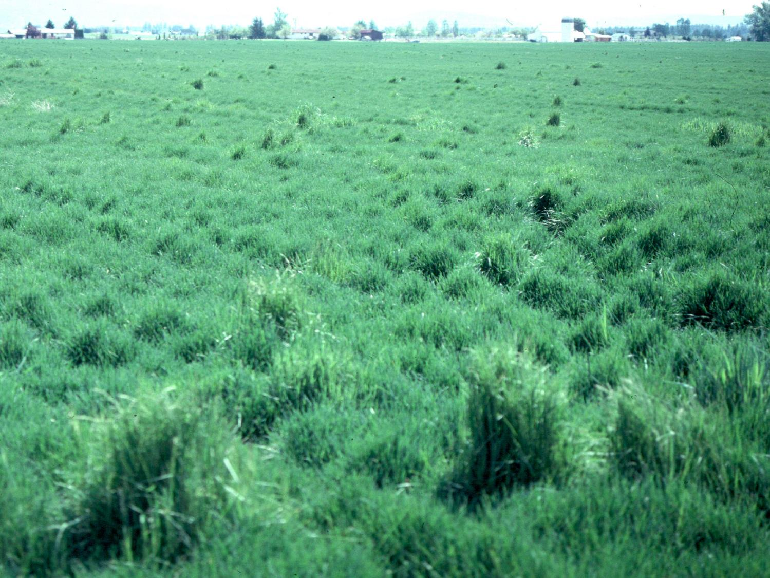
Back in the seed production field, the seed inspector, at heading time, makes an inspection for plants that either head earlier or later than the majority of the crop. These variant plants are termed off-types. The maximum percentage of off-types permitted is 2%. Technically, these are termed Other Crop seeds and if they exceed 2% the seedlot will fail certification and will not be issued a blue tag.
Off types
34

Slide 29
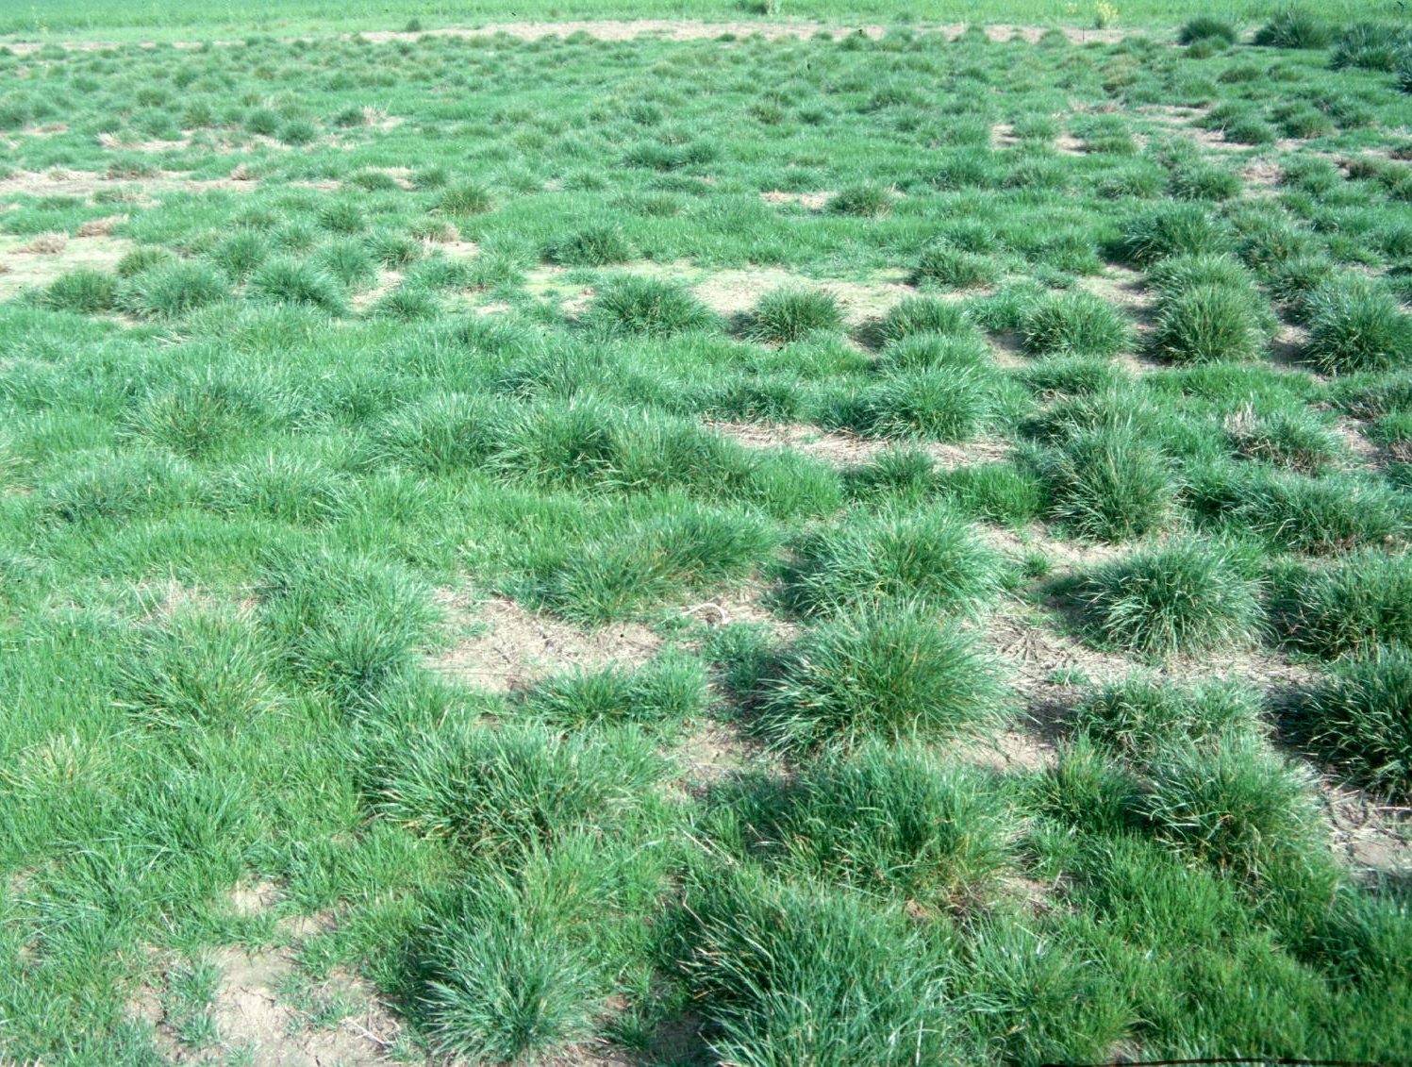
Another reason why a field may fail a blue tag certification is for volunteers. Volunteers occur from seed that shattered from the crop grown the previous year. You can see the larger plants which are surrounded by green fuzz that almost looks like a lawn. This fuzz resulted from seed that shattered and produced seedlings. Technically these seedlings would be considered one generation beyond the Certified generation and are classified as Other Crop with a maximum allowed percentage of 2%. Exceeding that would fail the certification and issuance of a blue tag for that field.
Volunteers = off-types
=other crop
35

Slide 30
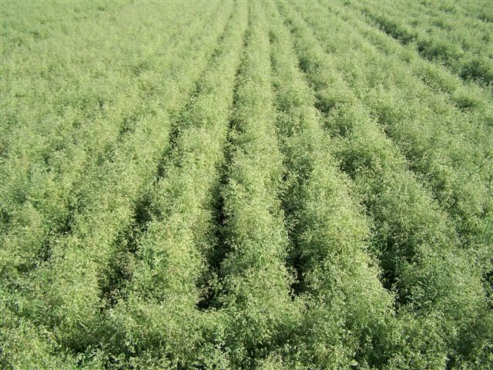
Back to the production field. Now the field is in full bloom. Fields are typically irrigated up to this point and beyond to make sure the seeds have time to fill.
43

Slide 31
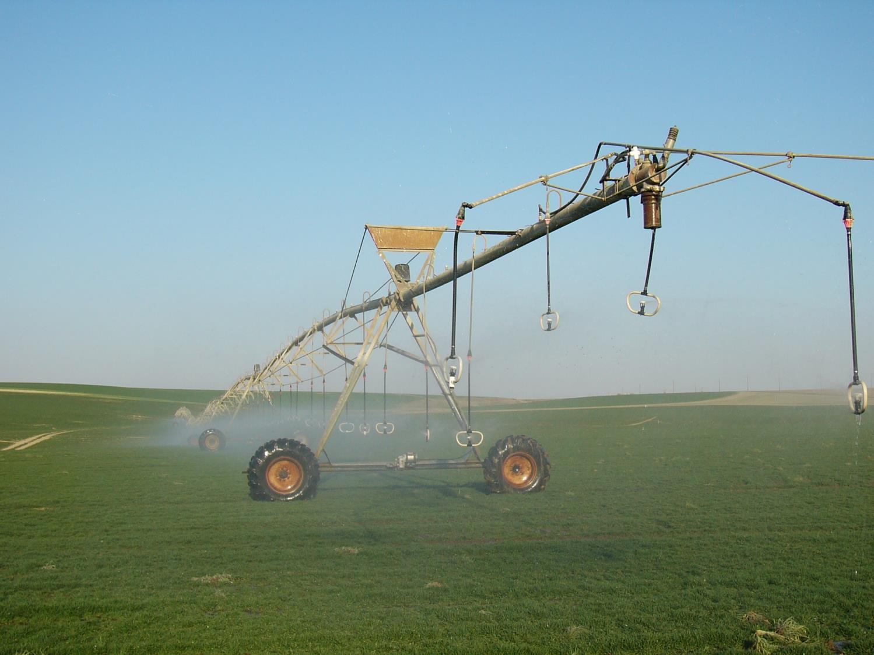
Turfgrass seed is often grown in a desert climate to control moisture. It is important to have a dry period in the summertime to harvest so that the seed won’t shatter and mold. Most turf seed is irrigated using a center pivot as shown in this photograph.
23

Slide 32
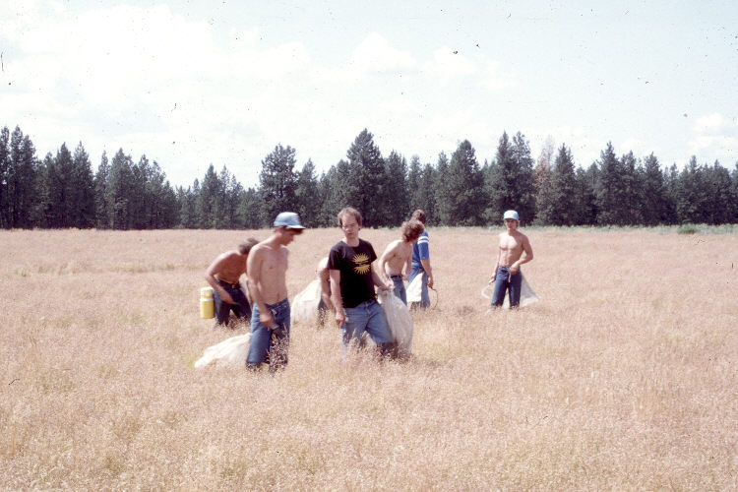
Last minute rogue
Even as the crop matures and dries down, a last minute rouging is sometimes done to remove off-type plants that surface at the last minute.
44

Slide 33
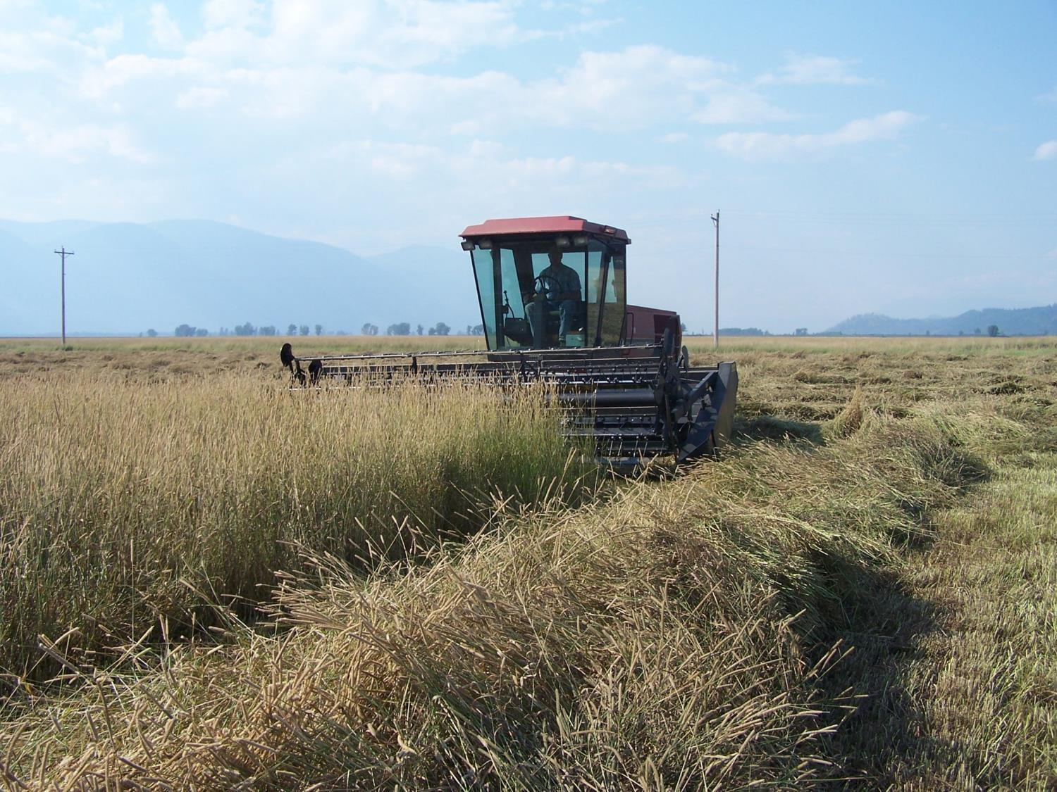
Harvest
Just before the seed is ripe, a swather goes through the fields and lays the crop down. A swather is usually used for cutting hay, but it was adapted for use in grass seed production
Swathing
46

Slide 34
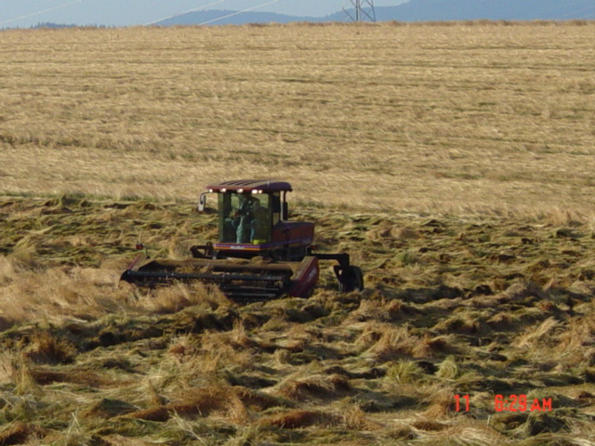
Swathing
Swathing is typically done at night when the crop is moist from dew so that seed does not shatter when cut. Shattering is when seeds fall from the seedheads to the ground. Unlike wheat which was bred to be shatter resistant, all turfgrasses shatter when they are ripe and harvested roughly. This reduces yield and profitability.
47

Slide 35
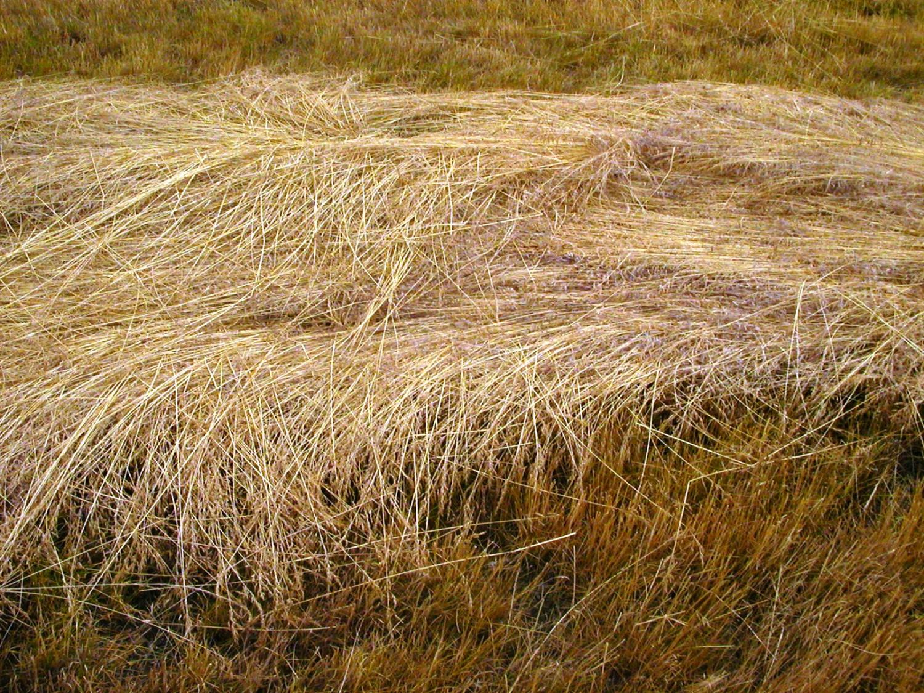
Swath pile drying and ripening
Shattering:
Seed falls from heads
Loss of yield
Ideal seed moisture:
8-12%
The swath piles are allowed to dry for 7-10 days in the sunlight which permits the seed to ripen. Seeds are drying to the ideal moisture of 8-12% which is important for storage. If stored above 12% moisture, the seed may mold and lose germination.
48

Slide 36
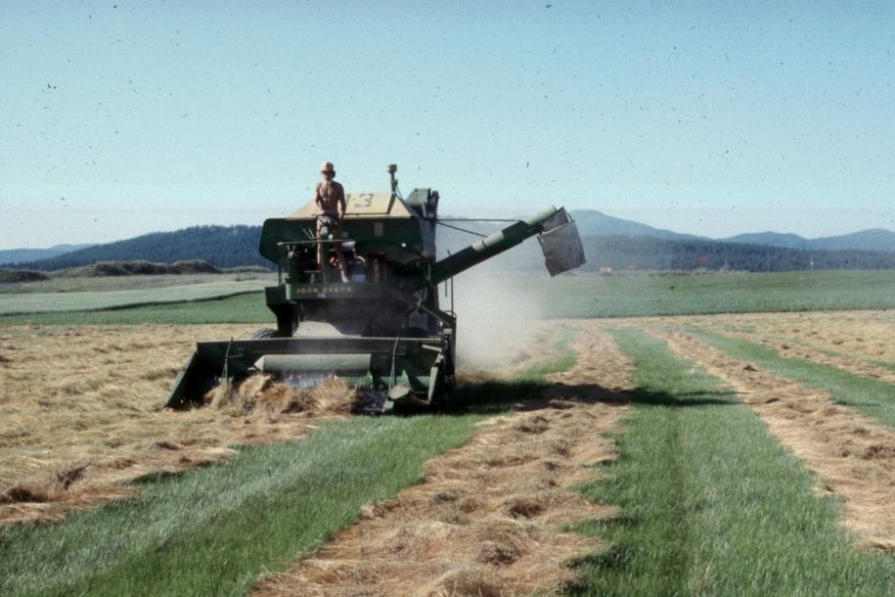
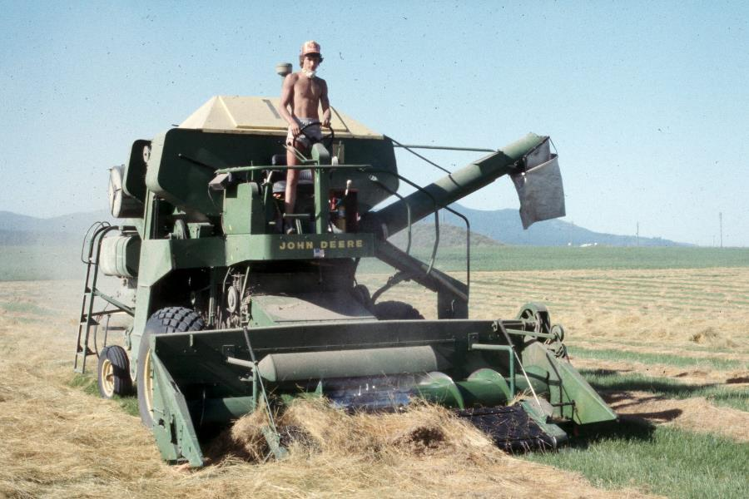
Harvest
Picking up swath piles
Rubbing seed from straw
About a week later a combine with a rip cylinder combs up the piles and removes the seed from the straw. The combine does a rough screening to get rid of stems which are output through the back of the combine.
49

Slide 37

After a grass seed crop is harvested, a lot of vegetative material is left behind. The question is: What do you do with all the leftover straw and stubble on a field? If left in place, it would shade out the crop. Turf is a perennial, reproducing a crop from crowns and rhizomes each following year. Field lifespans of 1-6 years are typical.
50

Slide 38
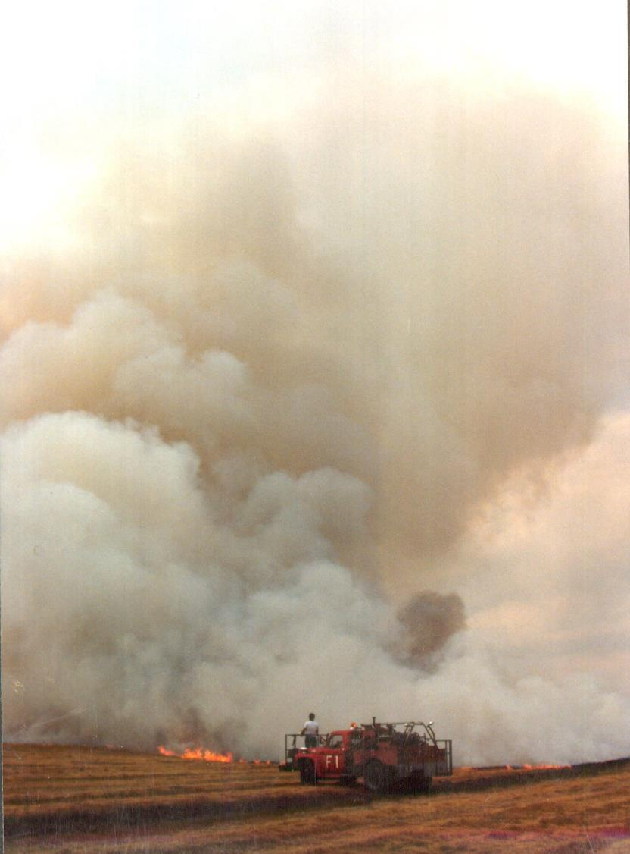
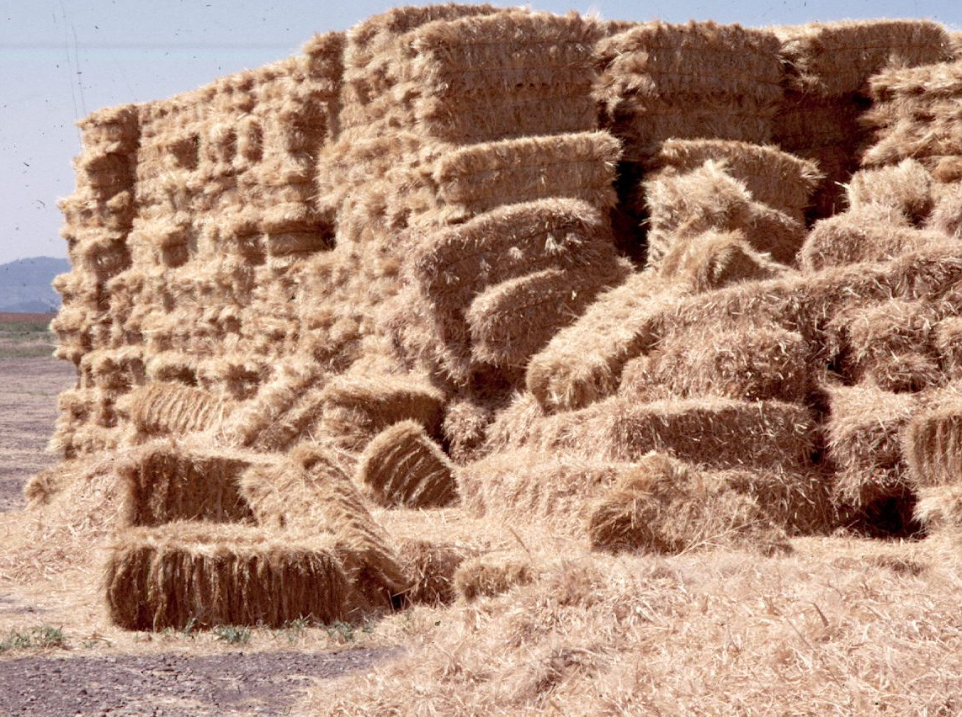
There can be lots and lots of straw produced from a typical production field. For many years the answer was field burning, where growees would actually set fire to their fields, producing huge, almost atomic bomb sized smoke plumes. This treatment shocked the plants and opened up the canopy to allow the regeneration of a new grass seed crop from rhizomes and crowns. Without burning, seed production is 10-40% of what it would be with field burning.
51

Slide 39

In addition to polluting the air, field burning has a number of undesirable hazards. Thus the practice is now banned in most western states. Burning is confined to seed production on reservations.
Burning has undesirable side-effects
52

Slide 40

There have been a number of field burning alternatives developed, such as the crewcut machine. It was developed to sweep up litter and allow a similar regeneration of the plant from crowns and rhizomes. This adds cost to the seed and the farmer. Some farmers have resorted to annual cropping of perennial grasses instead of incurring the expense of regenerating the stand.
Crew cut machine
53

Slide 41


Dumping field seed into conditioning plant
After the seed is harvested by the combine, it is loaded into trailers and brought into the conditioning plant and dumped into the receiving pit. On the right you can see a load of seed coming in from the field at typically 45 to 90% purity. This purity is not sufficient for seed consumers and has to be improved through a series of cleaners to 98% + purity.
54

Slide 42

Complex milling machines have not changed
in 100 years
Here is an advanced cleaning operation at Jacklin Seed in Post Falls, Idaho. Keep in mind that the basic concepts in these milling machines have not changed in the last century. The Clipper machine at the left is made out of wood; this basic design was used as far as back as the 1880’s.
55

Slide 43


How grass seed is cleaned
Grass seed is cleaned by three basic operations: Shaking sieves, buoyancy in an air current, or by a vibrating friction table like you see here. This separates out the seed based on its surface characteristics. It allows cleaning of weed seeds from troublesome lots. All this machinery does basically the same function as these two workers who are cleaning zoysia seed by hand, sieving it, throwing up in the air and removing chaff. The two processes are basically the same.

Slide 44


Blending
Before the seed is bagged, it is typically blended to combine several lots together. On the upper photograph you can see vibrator-fed blender that produces a very uniform mix compared to the older barrel-type mixer which uses a barrel and paddle to mix seed.
57

Slide 45

Bagging and storage
All seed companies have a bagged storage area because seed comes in during a 4 week period and takes 52 weeks before it leaves the factory.
55
58

Slide 46


During storage the seed is tested for bushel weight (on the left) using a miniature scale and volume container to determine bulk density. On the right, a probe is taken from each bag or box and sent to the official state seed lab for analysis.
Probing to send in seed sample for official lab analysis
Testing seedlot for bushel weight (=bulk density)

Slide 47



Weed seed
A registered seed technologist at Oregon State University Seed lab in Corvallis examines individual seeds sampled from a seedlot under test. She is looking for weed seeds like those shown in the above photograph. By sorting through the seeds and weighing the inert matter and weed seed it is possible to calculate a percent purity in the lot. A germination test is routinely run which requires 3 weeks to see how many seeds germinate. Or a tetrazolium test may be substituted which gives a quicker read out.
Tetrazolium (TZ) test – A quick (24-48 hour) biochemical viability test which determines the percentage of live seeds in a lot based on dehydrogenase activity. This is the same chemical used on CSI to determine living matter.
32

Slide 48


Seed germination testing
Germinating the seed in a controlled chamber under near optimal conditions is done to get a germination count. But this takes several weeks and delays the seed sales process.
33

Slide 49
This is the information you will find on a seed tag, as required by federal law
Kind and variety - species or common name, and cultivar or variety
Lot number - every bag in a “lot” is uniform relative to its labeling.
Origin - where the seed was grown.
Net weight - total bulk weight of bag.
Pure seed - (% Purity) A purity test separates pure seed, inert matter, other crop seed, and weed seed.
29

Slide 50
This is the information you will find on a seed tag, as required by federal law
Note: Purity + inert matter + weed seed+ other crop seed must add up to 100%.
Germination – (% Germination) a germination test determines the capability of a seed lot to produce normal seedlings under favorable conditions.
Germination test date - Seed test should be updated every 6-12 months depending upon species and state laws.
30

Slide 51
This is the information you will find on a seed tag, as required by federal law
Inert matter - (% Inert Matter) includes dirt, plant parts, and damaged seed.
Other crop seed - (% Other Crop) all seed not of the kind declared on the label.
Weed seeds - (% Weed Seed) weeds considered to be undesirable.
Name of restricted noxious seed - number per pound of seed.
Name/address of company responsible.
31

Slide 52

Tagging
After the seed is analyzed, only then are certification tags (blue tags) authorized. Here they are being applied by an operator.
60

Slide 53


Tagging
Sod quality seed (“gold tag”) – a higher mechanical quality, less weed seed
A custom blend
On the left is a custom blend tag that combines several Kentucky bluegrasses together, showing the purity and germination of each component. On the right is a sod quality or gold tag which is a higher mechanical quality used on sod farms. It is also used by golf courses and landscapers who desire a higher quality, weed free seed.
61

Slide 54




“Pre-forms”
Most turfgrass seed is not sold as a single variety, but as mixtures or blends. Typically you will see them in trade shows sold by a brand name such as “Premium Sod” which contains a “pre-form” or pre-formulated mixture of popular time tested varieties and ratios. For the consumer, this takes out a lot of the variety guesswork. Reputable companies will keep their best varieties cycled into their named pre-forms so as not to tarnish a good brand. Always work with a trusted seed supplier because pre-forms may change varietal makeup from one year to the next due to seed availability.

Slide 55
Certified Seed
Is your guarantee of varietal purity and seed quality
73

